Slide 1
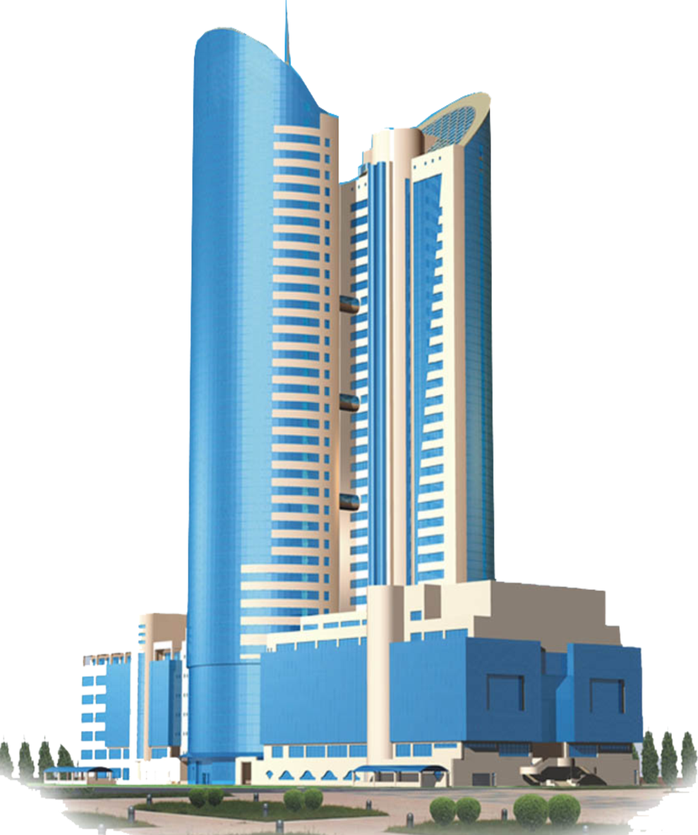
“NC "Kazakhstan Temir Zholy“ JSC RESULTS OF ACTIVITIES FOR THE 1ST HALF OF 2021 AND THE MAIN TASKS FOR THE SERVICES OF PROVISION OF ACCESS ROADS AND THE TRANSMISSION OF ELECTRIC ENERGY Nur-Sultan 29/07/2021

Slide 2
CONTENT OF THE REPORT
General information
On the volumes of provided regulated services
On the main financial and economic performance indicators
On the article-by-article execution of the approved tariff estimates for the 1st half of 2021
On the implementation of the investment program for the 1st half of 2021
About the ongoing work with the consumers of regulated services
About the prospects of activity

Slide 3
ACCESS ROAD SERVICES

Slide 4
ACCESS ROAD SERVICES
Service-1 - for the passage of rolling stock.
The balance of the branches of the Company has 170 access roads with a total length of 86.3 km
Service-2 - for shunting, loading unloading, as well as for parking of rolling stock, not provided for by technological operations of the transportation process.
For 6 months of 2021, access road services were provided to 498 consumers.
4

Slide 5
ABOUT EXECUTION OF THE TARIFF ESTIMATE FOR SERVICES OF ACCESS ROADS ACCORDING TO THE RESULTS OF THE 1ST HALF OF 2021 (SERVICE 1)
№ | Name of indicators of the tariff estimate | Units of measurement | Approved for 2021 | Fact for 6 months | Execution, (%)
I | The costs of producing goods and providing services, total, incl. | thousand tenge | 24 337,00 | 9 899,46 | 41
1 | Material costs, total, incl. | -"- | 9 083,00 | 1 822,02 | 20
1.1. | materials | -"- | 9 083,00 | 1 822,02 | 20
2 | Labor costs, total, incl.: | -"- | 8 953,32 | 4 685,07 | 52
2.1. | salary | -"- | 7 884,58 | 3 776,51 | 48
2.2. | social tax | -"- | 967,55 | 874,71 | 90
2.3. | Compulsory social health insurance | -"- | 101,19 | 33,85 | 33
3 | Depreciation of fixed and intangible assets | -"- | 6 280,12 | 3 392,37 | 54
4 | Other costs (medical services) | -"- | 20,92
II | Period expenses, total (taxes) | -"- | 2 416,41 | 1 379,83 | 57
III | Total costs | -"- | 26 753,41 | 11 279,29 | 42
IY | Profit | -"- | 2 715 | -476 | -18
Y | Total income | -"- | 29 469 | 10 803 | 37
YI | The volume of services provided | wagon-km | 198 745 | 72 860 | 37
YII | Tariff | tenge/ wagon-km | 148,27 | 148,27
5

Slide 6
ABOUT EXECUTION OF THE TARIFF ESTIMATE FOR SERVICES OF ACCESS ROADS ACCORDING TO THE RESULTS OF THE 1ST HALF OF 2021 (SERVICE 2)
№ | Name of indicators of the tariff estimate | Units of measurement | Approved for 2021 | Fact for 6 months | Execution, (%)
I | The costs of producing goods and providing services, total, incl. | thousand tenge | 22 464,60 | 9 137,96 | 41
1 | Material costs, total, incl. | -"- | 8 384,00 | 1 681,86 | 20
1.1. | materials | -"- | 8 384,00 | 1 681,86 | 20
2 | Labor costs, total, incl.: | -"- | 8 264,61 | 4 324,68 | 52
2.1. | salary | -"- | 7 278,08 | 3 486,01 | 48
2.2. | social tax | -"- | 893,12 | 807,43 | 90
2.3. | Compulsory social health insurance | -"- | 93,41 | 31,25 | 33
3 | Depreciation of fixed and intangible assets | -"- | 5 797,03 | 3 131,42 | 54
4 | Other costs (medical services) | -"- | 19,32
II | Period expenses, total (taxes) | -"- | 2 230,54 | 1 273,69 | 57
III | Total costs | -"- | 24 695,14 | 10 411,65 | 42
IY | Profit | -"- | 2 506 | 3 205 | 128
Y | Total income | -"- | 27 202 | 13 617 | 50
YI | The volume of services provided | wagon-km | 549 647 | 275 145 | 50
YII | Tariff | tenge/ wagon-km | 49,49 | 49,49
6

Slide 7
IMPLEMENTATION OF THE INVESTMENT PROGRAM
FOR THE SERVICES OF ACCESS ROADS BY THE RESULTS OF THE 1ST HALF OF 2021
thousand tenge
Name of the project | Units of measurement | Approved for 2021 |  | Fact for 6 months |  | deviation |  | Causes
 |  | volume | amount | volume | amount | volume | amount
Enhanced medium repair of the track along the station K-Borovoe RSP-1, access road No.6,7,8,9,10 | km | 1,493 | 17 300 | - | - | -1,493 | -17 300 | Expected to be executed in the second half of 2021, according to the enhanced medium repair schedule
7

Slide 8
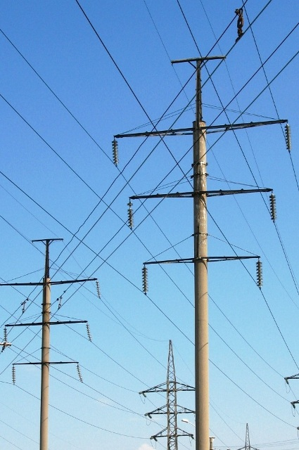
ELECTRIC POWER TRANSMISSION SERVICES

Slide 9
ELECTRIC POWER TRANSMISSION SERVICES
The Company includes 12 branches of the backbone network that provide services for the transmission of electrical energy.
In total, switchgears, transformer substations (TS) and complete transformer substations (CTS) - 7,031 units.
The company has power grid facilities:
power lines:
- 12 314.8 km,
installed capacity of TS, CTS - 1 164.6 (thousand kW).
4582
ТП и КТП
9

Slide 10
ABOUT EXECUTION OF THE TARIFF ESTIMATE FOR ELECTRIC POWER TRANSMISSION SERVICES BY THE RESULTS OF THE 1ST HALF OF 2021
№ | Name of indicators of the tariff estimate | Units of measurement | Approved for 2021 | Fact for 6 months | Execution, (%)
I | The costs of producing goods and providing services, total, incl. | thousand tenge | 1 858 802,93 | 1 308 300,70 | 70
1 | Material costs, total, incl. | -"- | 1 533 575,48 | 1 038 796,25 | 68
1.1 | materials | -"- | 20 179,09 | 7 521 | 37
1.2 | FUEL | -//- | 14 006,92 | 5 369 | 38
1.3 | energy | -//- | 1 499 389,48 | 1 025 906,25 | 68
2 | Labor costs, total, incl. | -//- | 282 702,52 | 238 196,45 | 84
2.1 | salary | -//- | 255 723,66 | 212 501,73 | 83
2.2 | social tax | -//- | 21 864,39 | 21 444,68 | 98
2.3 | Compulsory social health insurance |  | 5 114,47 | 4 250,03 | 83
3 | Depreciation of fixed and intangible assets | -//- | 40 695 | 30 481 | 75
4 | Third party services, including: | -//- | 1829,93 | 827 | 45
4.1 | utilities | -//- | 1 545,66 | 667,22 | 43
4.2 | communication services | -//- | 284,27 | 159,78 | 56
II | Period expenses, total (taxes) | -//- | 2 372,87 | 1 769,80 | 75
III | Total costs | -//- | 1 861 175,80 | 1 310 070,50 | 70
IV | Profit | -//- |  | -312 640,50
V | Total income | -//- | 1 861 175,80 | 997 430,00 | 54
VI | The volume of services provided | thousand kWh | 1 018 207,99 | 545 044,51 | 54
VII | Regulatory losses | % | 10,11 | 10,21 | 101
 |  | thousand kWh | 114 484,12 | 61 984,89 | 54
VIII | Tariff (excluding VAT) | tenge/kWh | 1,83 | 1,83
10

Slide 11
IMPLEMENTATION OF THE INVESTMENT PROGRAM FOR ELECTRIC POWER TRANSMISSION SERVICES BY THE RESULTS OF THE 1ST HALF OF 2021
thousand tenge
№ | Name of the project | Units of measurement | Approved for 2021 |  | Fact for 6 months |  | deviation
 |  |  | volume | amount | volume | amount | volume | amount
 | Всего |  | 10 | 40 694,33 |  |  |  | -40 694,33
1 | Complete switchgear KSO-2-10 with vacuum circuit breaker | set | 2 | 7 898,40 |  |  | -2 | -7 898,40
2 | Complete transformer substation KTPN-400kVa, 10/0.4 kV | set | 3 | 10 000,02 |  |  | -3 | -10 000,02
3 | Oil transformer TM-250/10/0.4kV | piece | 2 | 2 711,66 |  |  | -2 | -2 711,66
4 | Oil transformer TM-400/10/0.4kV | piece | 1 | 1 812,25 |  |  | -1 | -1 812,25
5 | Oil transformer TMZh-1600/27.5/0.4 kV | piece | 2 | 18 272,00 |  |  | -2 | -18 272,00
а
Currently, contracts have been concluded with JSC "Kentau Transformer Plant" No. 558651/2021/1 of 04/05/21, No. 562903/2021/1 of 12/05/2021, No. 562720/2021/1 of 13/05/2021.
11

Slide 12
WORK WITH CONSUMERS OF SERVICES FOR THE 1ST HALF OF 2021
for access road services:
1. Operative (accelerated) work with service consumers was ensured on the principle of one window:
- acceptance of the application;
- issue of a signed contract;
- registration of a statement of the supply and cleaning of wagons;
- carrying out the calculation (taxation of services) and acceptance of payment for services.
2. For the prompt dispatch and acceptance of consumer goods, an electronic shipping document is drawn up in an automated control system for contractual and commercial work at all branches of the road..
3. Following the results of 6 months of 2021, 498 contracts were concluded with consumers of services.
for electric power transmission services:
1. To improve the quality of the provision of services for the transmission of electric power, in terms of increasing the reliability of power supply, the following works are constantly being carried out:
- carrying out load measurements along 0.4 kV lines and ensuring uniform phase-by-phase distribution of the line load;
- the use of switchgears with vacuum switches, modern protections and automation devices, which ensure an increase in the reliability of power supply by selectively disconnecting the damaged section of the line and automatically switching on the reserve or automatically reclosing a section of the line with unstable short-term damage to the line;
2. . Following the results of 6 months of 2021, 624 contracts were concluded with consumers of services.
12

Slide 13
CURRENT AND PERSPECTIVE CHALLENGES
for access road services:
Ensuring traffic safety;
Overhaul of access roads in the approved amount;
Ensuring the current maintenance of access roads in accordance with the requirements of the Technical Operations Rules;
High-quality provision of services to consumers.
for electric power transmission services:
Improving the reliability of the Company's distribution networks;
Modernization of the Company's power supply devices;
Ensuring unimpeded access to a regulated service;
Ensuring quality service delivery to consumers.
13

Slide 14
THANK YOU FOR ATTENTION

