Slide 1

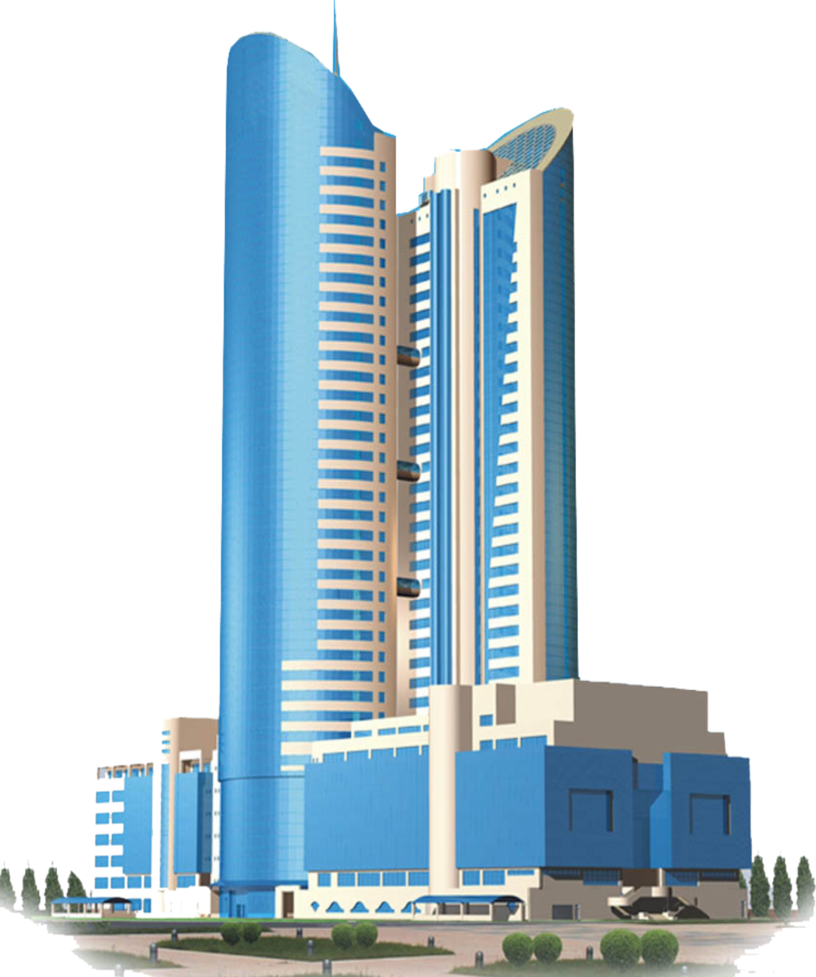

"National company
"Kazakhstan Temir Zholy" Joint Stock Company
RESULTS OF OPERATIONS FOR 2023
AND MAIN TASKS
FOR THE SERVICES OF PROVISION OF ACCESS ROADS AND TRANSMISSION OF ELECTRIC POWER
Astana 24/04/2024

Slide 2
CONTENT OF THE REPORT
General information
On the volumes of provided regulated services
On the main financial and economic indicators of activity
On the itemized execution of the approved tariff estimates for 2023
5. On the implementation of the investment program for 2024
About the ongoing work with the consumers of regulated services
On the prospects of activities (development plans)
2

Slide 3
ACCESS ROADS SERVICES

Slide 4
ACCESS ROADS SERVICES
Service 1 - for the passage of rolling stock.
The balance of the branches of the Company includes 170 access roads with a total length of 86.3 km at 53 stations.
Service 2 - for shunting operations, loading and unloading, as well as for parking the rolling stock, not foreseen by the technological operations of the transportation process.
In 2023 470 consumers used access roads.
4

Slide 5
ABOUT EXECUTION OF THE TARIFF ESTIMATE FOR SERVICES OF ACCESS ROADS ACCORDING TO THE RESULTS OF 2023 (SERVICE 1)
№ | Name of indicators of the tariff estimate | Units of measurement | Plan | Fact | Execution,%
I | The costs of producing goods and providing services, total, including: | thousand tenge | 34 066,04 | 40 385,00 | 119
1. | Material costs, total, incl.: | -“- | 9 823,77 | 10 992,70 | 112
1.1. | Materials | -"- | 9 823,77 | 10 992,70 | 112
1.2. | Fuel | -"-
1.3. | Energy | -"-
2. | Labor costs, total, incl. | -"- | 17 728,88 | 20 427,47 | 115
2.1. | Salary | -"- | 15 371,05 | 16 728,02 | 109
2.2. | Social tax | -"- | 2 101,73 | 3 393,42 | 161
2.3. | MSHI (mandatory social health insurance) | -"- | 256,1 | 306,03 | 119
3. | Depreciation of fixed and intangible assets | -"- | 6 490,76 | 8 942,80 | 138
4. | Other costs (medical services) | -"- | 22,63 | 22,03 | 97
II | Period expenses, total (taxes) | -"- | 2 613,59 | 3 325,60 | 127
III | Total costs | -"- | 36 679,63 | 43 710,60 | 119
IV | Profit | -"- | 2 815,06 | -23 209,32
V | Total income | -"- | 39 494,69 | 20 501,28 | 52
VI | Unreasonably received income for non-fulfillment of TE and IP | -"- | 1 156,04
VII | Total income including unjustified income | -"- | 38 338,65 | 20 501,28 | 53
 | 01.01- 30.09 | -"- |  | 13 135,54
 | 01.10 - 31.10 | -"- |  | 1 935,23
 | 01.11 - 31.12 |  |  | 5 430,52
6 | The volume of services provided | wagon/km | 198 745 | 138 015 | 69
 | 01.01- 30.09 |  |  | 91 966
 | 01.10 - 31.10 |  |  | 10 032
 | 01.11 - 31.12 |  |  | 36 016
7 | Tariff period 01.01 - 30.09 | tenge | 142,83 | 142,83
 | Tariff period 01.10 - 30.10 |  | 192,90 | 192,90
 | Tariff period 01.11 - 31.12 |  | 150,78 | 150,78
 | Reference:
 | Average number of production personnel | person | 7,54 | 7,82
 | Average monthly salary | tenge | 169 883 | 178 243
5

Slide 6
ABOUT EXECUTION OF THE TARIFF ESTIMATE FOR SERVICES OF ACCESS ROADS ACCORDING TO THE RESULTS OF 2023 (SERVICE 2)
№ | Name of indicators of the tariff estimate | Units of measurement | Plan | Fact | Execution,%
I | The costs of producing goods and providing services, total, including: | thousand tenge | 31 445,59 | 37 278,46 | 119
1. | Material costs, total, incl.: | -“- | 9 068,10 | 10 147,11 | 112
1.1. | Materials | -"- | 9 068,10 | 10 147,11 | 112
1.2. | Fuel | -"- |  |  | 0
1.3. | Energy | -"-
2. | Labor costs, total, incl. | -"- | 16 365,12 | 18 856,13 | 115
2.1. | Salary | -"- | 14 188,66 | 15 441,25 | 109
2.2. | Social tax | -"- | 1 940,06 | 3 132,39 | 161
2.3. | MSHI (mandatory social health insurance) | -"- | 236,40 | 282,49 | 119
3. | Depreciation of fixed and intangible assets | -"- | 5 991,48 | 8 254,89 | 138
4. | Other costs (medical services) | -"- | 20,89 | 20,33 | 97
II | Period expenses, total (taxes) | -"- | 2412,55 | 3069,78 | 127
III | Total costs | -"- | 33 858,14 | 40 348,24 | 119
IV | Profit | -"- | 2 598,51 | -6 922,08
V | Total income | -"- | 36 456,65 | 33 426,15 | 92
VI | Unreasonably received income for non-fulfillment of TE and IP | -"- | 1 048,10
VII | Total income including unjustified income | -"- | 35 408,55 | 33 426,15 | 94
 | 01.01- 30.09 | -"- |  | 21 630,45
 | 01.10 - 31.10 | -"- |  | 4 425,63
 | 01.11 - 31.12 | -"- |  | 7 370,08
6 | The volume of services provided | wagon/hour | 549 647 | 668 801 | 122
 | 01.01- 30.09 |  |  | 453 754
 | 01.10 - 31.10 |  |  | 68 700
 | 01.11 - 31.12 |  |  | 146 348
7 | Tariff period 01.01 - 30.09 | tenge | 47,67 | 47,67
 | Tariff period 01.10 - 30.10 |  | 64,42 | 64,42
 | Tariff period 01.11 - 31.12 |  | 50,36 | 50,36
 | Reference:
 | Average number of production personnel | person | 6,96 | 7,22
 | Average monthly salary | tenge | 169 883 | 178 243
6

Slide 7
IMPLEMENTATION OF THE INVESTMENT PROGRAM
FOR THE SERVICES OF ACCESS ROADS BY THE RESULTS OF 2023
Name of the project | fact
 | volume, km | amount, thousand tenge
Total for the services of the provision of access roads of JSC "NC" KTZh ", including: | 25 | 17 964
Purchase of small-scale mechanization equipment | 25 | 17 964
7

Slide 8
ELECTRIC POWER TRANSMISSION SERVICES

Slide 9
ELECTRIC POWER TRANSMISSION SERVICES
The Company includes 12 branches of the backbone network that provide services for the transmission of electrical energy.
The company has power grid facilities:
power lines - 12 314.8 km, installed capacity of TS, CTS - 1 164.6 (thousand kW).
In total, switchgears, transformer substations (TS) and complete transformer substations (CTS) - 7,031 units. There are 2,449 switchgears and 4,582 transformer substations (TS) and complete transformer substations (CTS).
In 2023, 695 consumers used electricity transmission services.
4582
TS and CTS
2449 switchgears
9

Slide 10
ABOUT EXECUTION OF THE TARIFF ESTIMATE FOR ELECTRIC
POWER TRANSMISSION SERVICES BY THE RESULTS OF 2023
№ | Name of indicators |  |  | Units of measurement | Plan | Fact | Execution,%
I | The costs of producing goods and providing services, total, including: |  |  | thousand tenge | 2 476 826,79 | 3 492 753,68 | 141
1 | Material costs, total, incl. |  |  | -//- | 1 871 743,20 | 2 523 508,50 | 135
1.1. | Materials |  |  | -//- | 21 825,70 | 25 124,63 | 115
1.2. | Fuel |  |  | -//- | 15 149,88 | 15 337,46 | 101
1.3. | Energy |  |  | -//- | 1 834 767,62 | 2 483 046,41 | 135
2 | Labor costs, total, incl. |  |  | -//- | 565 712,33 | 906 731,09 | 160
2.1. | Salary |  |  | -//- | 507 137,90 | 802 705,83 | 158
2.2. | Social tax |  |  | -//- | 43 360,29 | 79 944,08 | 184
2.3. | MSHI (mandatory social health insurance) |  |  | -//- | 15 214,14 | 24 081,17 | 158
3 | Depreciation of fixed and intangible assets |  |  | -//- | 37 392,00 | 60 199,69 | 161
4 | Third-party services, including: |  |  | -//- | 1 979,26 | 2 314,41 | 117
4.1. | Utilities |  |  | -//- | 1 671,79 | 1 975,41 | 118
4.2. | Communication services |  |  | -//- | 307,47 | 339,00 | 110
II | Period expenses, total (taxes) |  |  | -//- | 2 075,85 | 3 262,90 | 157
III | Total costs |  |  | -//- | 2 478 902,64 | 3 496 016,58 | 141
 | Profit |  |  | -//- |  | -996 242,08
IV | Total income |  |  | -//- | 2 478 902,64 | 2 499 774,50 | 101
 | Period 01.01 - 30.04 |  |  | -//- |  | 1 225 716,82
 | Period 01.05 - 31.12 |  |  | -//- |  | 1 274 057,68
V | The volume of services provided |  |  | thousand kWh | 1 018 207,99 | 1 086 559,14 | 107
 | Period 01.01 - 30.04 |  |  |  |  | 562 255,42
 | Period 01.05 - 31.12 |  |  |  |  | 524 303,72
VI | Regulatory losses |  |  | % | 10,11 | 10,11
 |  |  |  | thousand kWh | 114 484,12 | 122 234,70 | 107
VII | Tariff period 01.01 - 30.04 |  |  | tenge/kWh | 2,43 | 2,18
 | Tariff period 01.05 - 31.12 |  |  |  |  | 2,43
 | Reference:
 | Average number of production personnel |  |  | person | 229 | 227
 | Average monthly salary |  |  | tenge | 184 548 | 294 679
10

Slide 11
IMPLEMENTATION OF THE INVESTMENT PROGRAM FOR ELECTRIC POWER TRANSMISSION SERVICES BY THE RESULTS OF 2023
Name of the project | Plan |  | Fact
 | number, set | amount, thousand tenge | number, set | amount, thousand tenge
Name of activities Total for EPT services of JSC NC "KTZ" including: | 16 | 37 367,35 | 16 | 68 881,91
Complete switchgear type KSO-2-10 with a vacuum circuit breaker | 2 | 8 530,27 | 2 | 18 480,00
Transformer TM250/10/0,4 kV | 5 | 7 321,48 | 5 | 14 668,95
Transformer TM-400/10/0,4 kV | 7 | 13 720,91 | 7 | 22 782,17
Transformer TM-630/10/0,4 kV | 1 | 2 943,75 | 1 | 4 986,97
Transformer TMZH-400/27,5/0,4 kV | 1 | 4 850,94 | 1 | 7 963,82
а
11

Slide 12
WORK WITH CONSUMERS OF SERVICES FOR 2023
for access roads services:
1. Operative (accelerated) work with service consumers was ensured on the principle of one window:
- acceptance of the application;
- issue of a signed contract;
- registration of a statement of the supply and cleaning of wagons;
- carrying out the calculation (taxation of services) and acceptance of payment for services.
2. For the prompt dispatch and acceptance of consumer goods, an electronic shipping document is drawn up in an automated control system for contractual and commercial work at all branches of the road.
3. At the end of 2023, 470 contracts were concluded with consumers of services.
for electric power transmission services:
1. To improve the quality of the provision of service for the transmission of electric power, in terms of increasing the reliability of power supply, the following works are constantly being carried out:
- carrying out load measurements along 0.4 kV lines and ensuring uniform phase-by-phase distribution of the line load;
- the use of switchgears with vacuum switches, modern protections and automation devices, which ensure an increase in the reliability of power supply by selectively disconnecting the damaged section of the line and automatically switching on the reserve or automatically reclosing a section of the line with unstable short-term damage to the line.
2. In 2023, a total of 695 contracts were concluded with consumers of services.
12

Slide 13
CURRENT AND PERSPECTIVE CHALLENGES
For access road services:
Ensuring traffic safety;
Overhaul of access roads in the approved amount;
Reducing the general wear and tear of access roads;
Ensuring the current maintenance of access roads in accordance with the requirements of the Technical Operations Rules;
High-quality provision of services to consumers.
For electric power transmission services:
Improving the reliability of the Company's distribution networks;
Modernization of the Company's power supply devices;
Ensuring unimpeded access to a regulated service;
Ensuring quality service delivery to consumers.
13

Slide 14
THANK YOU FOR ATTENTION

