Slide 1
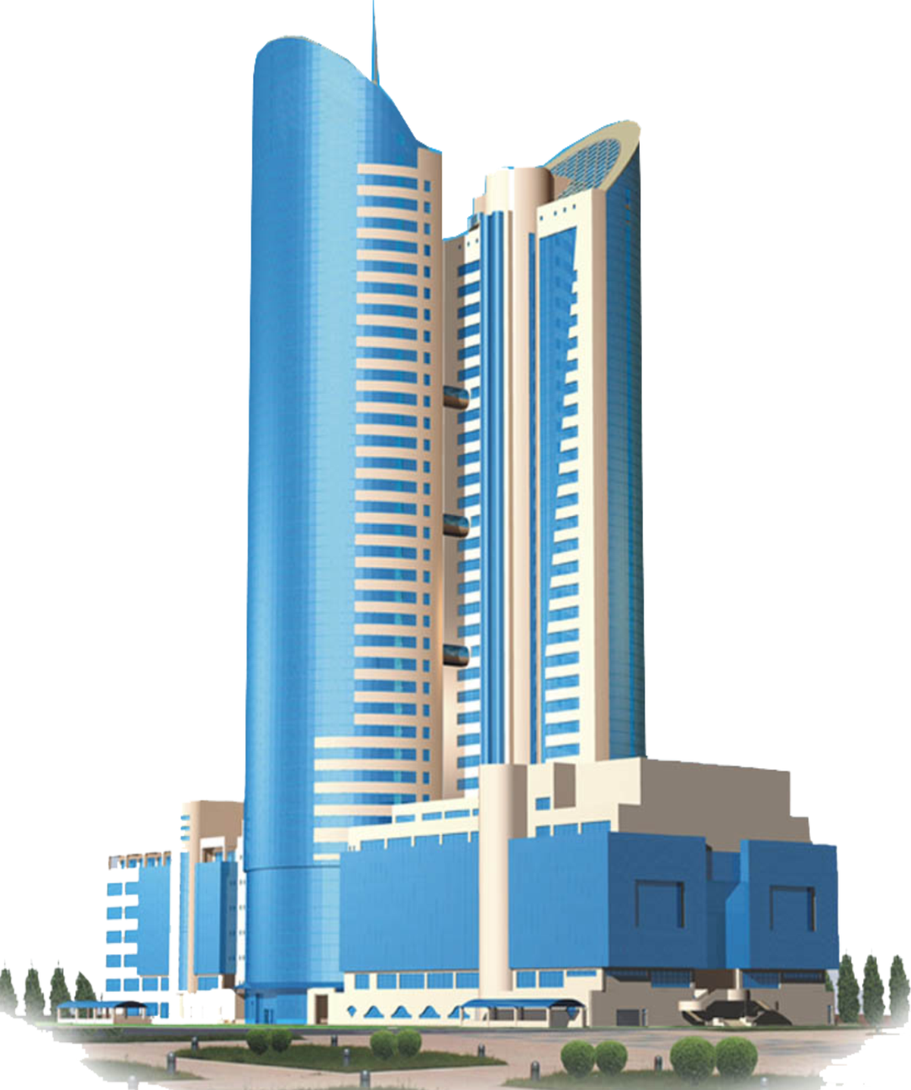
"National company "Kazakhstan Temir Zholy" Joint Stock Company RESULTS OF OPERATIONS FOR 2021 AND MAIN TASKS FOR THE SERVICES OF PROVISION OF ACCESS ROADS AND TRANSMISSION OF ELECTRIC POWER Nur-Sultan 22/04/2022

Slide 2
CONTENT OF THE REPORT
General information
On the volumes of provided regulated services
On the main financial and economic indicators of activity
On the itemized execution of the approved tariff estimates for 2021
5. On the implementation of the investment program for 2021
About the ongoing work with the consumers of regulated services
On the prospects of activities (development plans)

Slide 3
Access roads services

Slide 4
ACCESS ROADS SERVICES
Service 1 - for the passage of rolling stock.
The balance of the branches of the Company includes 170 access roads with a total length of 86.3 km at 53 stations.
Service 2 - for shunting operations, loading and unloading, as well as for parking the rolling stock, not foreseen by the technological operations of the transportation process.
In 2021 462 consumers used access roads.
1

Slide 5
ABOUT EXECUTION OF THE TARIFF ESTIMATE FOR SERVICES OF ACCESS ROADS ACCORDING TO THE RESULTS OF 2021 (SERVICE 1)
№ | Name of indicators of the tariff estimate | Units of measurement | Plan | Fact | Execution,%
I | The costs of producing goods and providing services, total, incl. | thousand tenge | 24 337,00 | 29 302,73 | 120
1. | Material costs, total, incl. | -“- | 9 083,00 | 9 541,18 | 105
1.1. | materials | -"- | 9 083,00 | 9 541,18 | 105
1.2. | fuel | -"-
1.3. | energy | -"-
2. | Labor costs, total, incl. | -"- | 8 953,32 | 13 053,12 | 146
2.1. | salary | -"- | 7 884,58 | 10 693,39 | 136
2.2. | social tax | -"- | 967,55 | 2 237,85 | 231
2.3. | MSHI (mandatory social health insurance) |  | 101,19 | 121,88 | 120
3. | Depreciation of fixed and intangible assets | -"- | 6 280,12 | 6 687,03 | 107
4. | Other costs (medical services) | -"- | 20,92 | 21,40 | 102
II | Period expenses, total (taxes) | -"- | 2 416,41 | 2 727,36 | 113
III | Total costs | -"- | 26 753,41 | 32 030,09 | 120
IV | Profit | -"- | 2 715,14 | -7 370,87 | -
V | Total income | -"- | 29 468,55 | 24 659,22 | 84
VI | The volume of services provided | wagon-km | 198 745 | 166 313 | 84
VII | Tariff | tenge/ wagon-km | 148,27 | 148,27
2

Slide 6
ABOUT EXECUTION OF THE TARIFF ESTIMATE FOR SERVICES OF ACCESS ROADS ACCORDING TO THE RESULTS OF 2021 (SERVICE 2)
№ | Name of indicators of the tariff estimate | Units of measurement | Plan | Fact | Execution,%
I | The costs of producing goods and providing services, total, incl. | thousand tenge | 22 464,93 | 27 048,67 | 120
1. | Material costs, total, incl. | -“- | 8 384,00 | 8 807,24 | 105
1.1. | materials | -"- | 8 384,00 | 8 807,24 | 105
1.2. | fuel | -"-
1.3. | energy | -"-
2. | Labor costs, total, incl. | -"- | 8 264,61 | 12 049,04 | 146
2.1. | salary | -"- | 7 278,08 | 9 870,82 | 136
2.2. | social tax | -"- | 893,12 | 2 065,71 | 231
2.3. | MSHI (mandatory social health insurance) |  | 93,41 | 112,50 | 120
3. | Depreciation of fixed and intangible assets | -"- | 5 797,03 | 6 172,64 | 107
4. | Other costs (medical services) | -"- | 19,32 | 19,76 | 102
II | Period expenses, total (taxes) | -"- | 2 230,54 | 2 517,57 | 113
III | Total costs | -"- | 24 695,47 | 29 566,24 | 120
IY | Profit | -"- | 2 506,28 | -1 530,65
Y | Total income | -"- | 27 201,75 | 28 035,59 | 103
YI | The volume of services provided | wagon- hour | 549 647 | 566 490 | 103
YII | Tariff | tenge/ wagon- hour | 49,49 | 49,49
3

Slide 7
IMPLEMENTATION OF THE INVESTMENT PROGRAM
FOR THE SERVICES OF ACCESS ROADS BY THE RESULTS OF 2021
Name of the project | plan |  | fact
 | volume, km | amount, thousand tenge | volume, km | amount, thousand tenge
Total for the services of the provision of access roads of JSC "NC" KTZh ", including: | 1,493 | 17 300 | 1,493 | 29 909
Reinforced middle track repair of the access road No. 6 of the K-Borovoe st. RSP-1 | 0,818 | 9 478 | 0,818 | 15 850
Reinforced middle track repair of the access road No. 7 of the K-Borovoe st. RSP-1 | 0,197 | 2 283 | 0,197 | 4 543
Reinforced middle track repair of the access road No. 8 of the K-Borovoe st. RSP-1 | 0,157 | 1 819 | 0,157 | 3 359
Reinforced middle track repair of the access road No. 9 of the K-Borovoe st. RSP-1 | 0,197 | 2 283 | 0,197 | 3 522
Reinforced middle track repair of the access road No. 10 of the K-Borovoe st. RSP-1 | 0,124 | 1437 | 0,124 | 2635
4

Slide 8
Electric power transmission services

Slide 9
ELECTRIC POWER TRANSMISSION SERVICES
The Company includes 12 branches of the backbone network that provide services for the transmission of electrical energy.
In 2021, 670 consumers used electricity transmission services.
In total, switchgears, transformer substations (TS) and complete transformer substations (CTS) - 7,031 units. There are 2,449 switchgears and 4,582 transformer substations (TS) and complete transformer substations (CTS).
The company has power grid facilities:
power lines:
- 12 314.8 km,
installed capacity of TS, CTS - 1 164.6 (thousand kW).
4582
TS and CTS
2449 switchgears
5

Slide 10
ABOUT EXECUTION OF THE TARIFF ESTIMATE FOR ELECTRIC POWER TRANSMISSION SERVICES BY THE RESULTS OF 2021
№ | Name of indicators | Units of measurement | Plan | Fact | Execution,%
I | The costs of producing goods and providing services, total, incl. | thousand tenge | 1 945 925,55 | 2 605 266,39 | 134
1 | Material costs, total, incl. | -//- | 1 620 698,10 | 2 048 526,68 | 126
1.1 | materials | -//- | 20 179,09 | 21 151,25 | 105
1.2 | fuel | -//- | 14 006,92 | 14 002,29 | 100
1.3 | energy | -//- | 1 586 512,10 | 2 013 372,14 | 127
2 | Labor costs, total, incl. | -//- | 282 702,52 | 494 083,68 | 175
2.1 | salary | -//- | 255 723,66 | 438 569,08
2.2 | social tax | -//- | 21 864,39 | 46 743,22
2.3 | MSHI (mandatory social health insurance) | -//- | 5 114,47 | 8 771,38
3 | Depreciation of fixed and intangible assets | -//- | 40 695,00 | 60 720,04 | 149
4 | Third party services, including: | -//- | 1 829,93 | 1 936,99 | 106
4.1 | utilities | -//- | 1 545,66 | 1 652,25
4.2 | communication services | -//- | 284,27 | 284,74
II | Period expenses, total (taxes) | -//- | 2 372,87 | 2 853,19 | 120
III | Total costs | -//- | 1 948 298,42 | 2 608 119,57 | 134
IV | Profit | -//- |  | -617 150,05
V | Total income | -//- | 1 948 298,42 | 1 990 969,52 | 102
 | period 01.01 - 30.09 | -//- |  | 1 409 416,82
 | period 01.10 - 31.12 | -//- |  | 581 552,70
VI | The volume of services provided | thousand kWh | 1 018 207,99 | 1 074 635,21 | 106
 | period 01.01 - 30.09 |  |  | 769 643,94
 | period 01.10 - 31.12 |  |  | 304 991,27
VII | Regulatory losses | % | 10,11 | 10,26
 |  | thousand kWh | 114 484,12 | 122 855,03 | 107
VIII | Tariff (excluding VAT) | tenge/kWh | 1,91 | 1,83
 | period 01.01 - 30.09 |  |  | 1,91
 | period 01.10 - 31.12
6

Slide 11
IMPLEMENTATION OF THE INVESTMENT PROGRAM
FOR ELECTRIC POWER TRANSMISSION SERVICES BY THE RESULTS OF 2021
Name of the project | Plan |  | Fact
 | number, set | amount, thousand tenge | number, set | amount, thousand tenge
Name of activities Total for EPT services of JSC NC "KTZ" including: | 10 | 40 694,33 | 18 | 60 811,34
Complete switchgear type KSO-2-10 with a vacuum circuit breaker | 2 | 7 898,40 | 2 | 7 819,28
Contact transformer substation KTPN-400 kW/10 kV | 3 | 10 000,02 | 3 | 9 100,06
Transformer TM250/10/0,4 kV | 2 | 2 711,66 | 3 | 4 067,58
Transformer TM-400/10/0,4 kV | 1 | 1 812,25 | 3 | 5 437,07
Transformer TM-630/10/0,4 kV |  |  | 2 | 5 443,26
Transformer TM-1000/10/0,4 kV |  |  | 1 | 4 150,92
Transformer TMZH-100/27,5/0,4 kV |  |  | 1 | 2 035,76
Transformer TMZH-400/27,5/0,4 kV |  |  | 1 | 4 484,97
Transformer TMZH-1600/27,5/10 kV | 2 | 18 272,00 | 2 | 18 272,45
а
7

Slide 12
WORK WITH CONSUMERS OF SERVICES FOR 2021
for access roads services:
1. Operative (accelerated) work with service consumers was ensured on the principle of one window:
- acceptance of the application;
- issue of a signed contract;
- registration of a statement of the supply and cleaning of wagons;
- carrying out the calculation (taxation of services) and acceptance of payment for services.
2. For the prompt dispatch and acceptance of consumer goods, an electronic shipping document is drawn up in an automated control system for contractual and commercial work at all branches of the road..
3. At the end of 2021, 462 contracts were concluded with consumers of services.
for electric power transmission services:
1. To improve the quality of the provision of service for the transmission of electric power, in terms of increasing the reliability of power supply, the following works are constantly being carried out:
- carrying out load measurements along 0.4 kV lines and ensuring uniform phase-by-phase distribution of the line load;
- the use of switchgears with vacuum switches, modern protections and automation devices, which ensure an increase in the reliability of power supply by selectively disconnecting the damaged section of the line and automatically switching on the reserve or automatically reclosing a section of the line with unstable short-term damage to the line.
2. 670 contracts were concluded with consumers of service.
8

Slide 13
CURRENT AND PERSPECTIVE CHALLENGES
for access road services:
Ensuring traffic safety;
Overhaul of access roads in the approved amount;
Reducing the general wear and tear of access roads;
Ensuring the current maintenance of access roads in accordance with the requirements of the Technical Operations Rules;
High-quality provision of services to consumers.
for electric power transmission services:
Improving the reliability of the Company's distribution networks;
Modernization of the Company's power supply devices;
Ensuring unimpeded access to a regulated service;
Ensuring quality service delivery to consumers.
9

Slide 14
THANK YOU FOR ATTENTION

